Slide 1






Artificial Intelligence
Workshop
15th February 2018
/UoGfintech
@UoGfintech
@uogfintech
UoG FinTech Society

Slide 2







Our Team
Aliou Amar
Jiaxing Sun
Mathematics and Computer Science
M.Sc. Financial Risk Managment
Milo Krawiec
Jim Brysland
Software Engineering
Cryptographer
Lenka Marčanová
Business and Management
Aleksandra Waluga
Amantle Khachana
B.Acc. Accounting & Finance
B.Acc. Accounting & Finance

Slide 3

Artificial
Intelligence

Slide 4
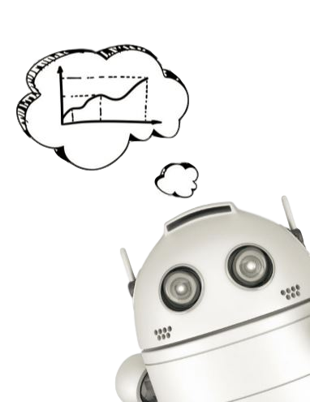
Definition: What is Intelligence? .
“The ability or inclination to perceive or deduce information, and to retain it as knowledge to be applied towards adaptive behaviors within an environment or context.”
Turing, Alan (October 1950) “Computing Machinery and Intelligence”
ᴸ> first academic approach to define AI
Turing Test or “Imitation Game”

Slide 5
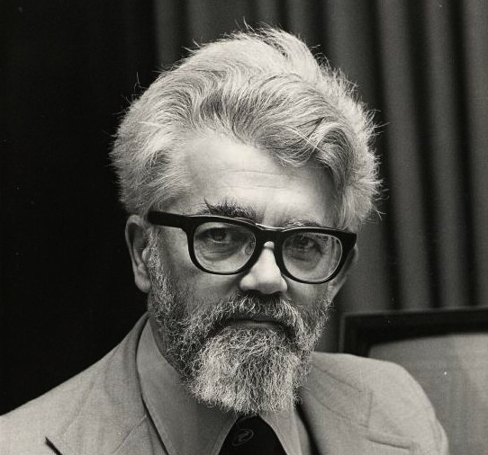
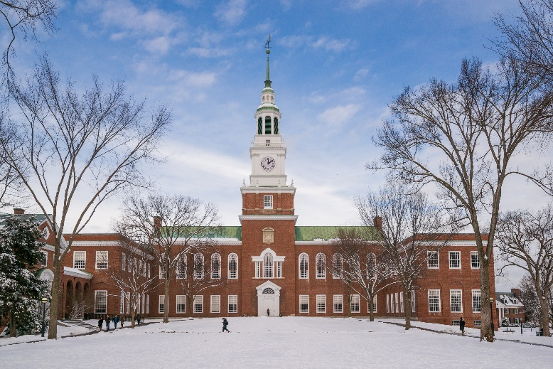
The Birthplace of Artificial Intelligence
John McCarthy & others
Darthmouth Summer Research Project on Artificial Intelligence (1956)
About the project
The project was advertised to last six to eight weeks, essentially an extended brainstorming session, with many leading researchers attending from fields such as complexity theory, language simulation, neuron nets, abstraction of content from sensory inputs, relationship of randomness to creative thinking, and learning machines.

Slide 6
Research & Development
01
Initial interest
Artificial Intelligence research benefited from millions in grants and funding.
AI Winter
02
Professor Sir James Lighthill & Debate 1973 (known as “The Lighthill Debate on BBC “Controversy” series)
03
Recently
Fluctuating interest & funding

Slide 7
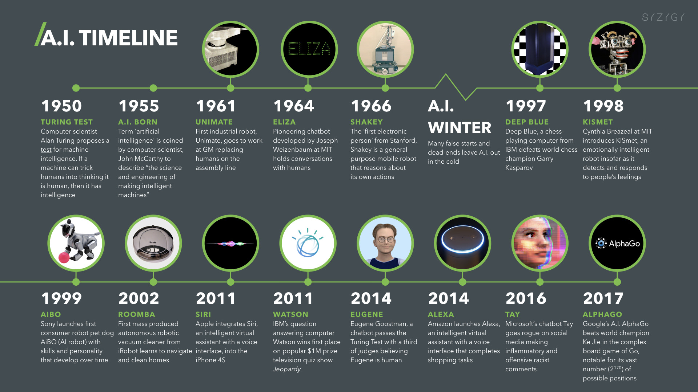
Milestones

Slide 8
Artificial Intelligence
& Blockchain

Slide 9
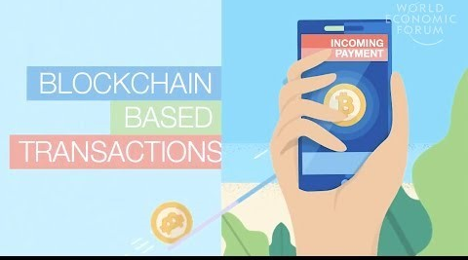
What is blockchain?
A blockchain is a digital and decentralised public ledger of all recorded cryptocurrency transactions.
Blocks and Incentives
Blockchain solves the well known “double spending” problem. when trying to create digital cash systems. i.e.: CD

Slide 10

What is DeepBrain chain?
DeepBrain Chain’s vision is to provide a private, safe and low-cost decentralised artificial intelligence computing platform to AI companies using blockchain technology.
What problem are they solving?
Expensive computational power to test and run.
Training of AI’s is costly.
Example: one game of DeepMinds ‘go’ costs the company over $3,000.
DEEPBRAIN CHAIN
Large venture funding of the industry at $22.4 Billion

Slide 11

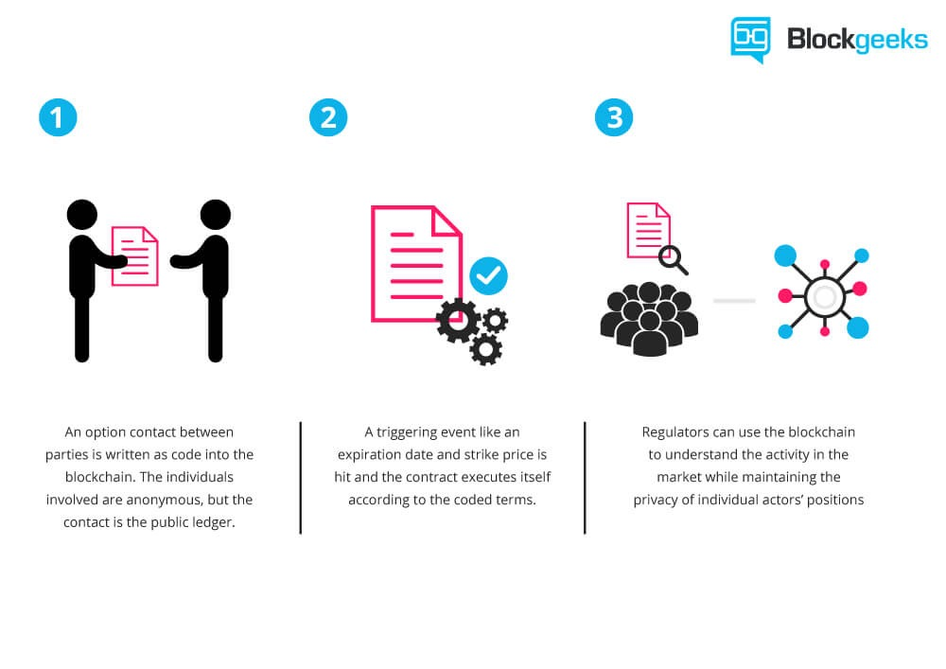


DBC ON
NEO
Smart Contracts
1.
2.
3.
Resources
Network resources managed easily
Transparency
An option contract between parties is written as code into the blockchain. The individuals involved are anonymous, but the contact is the public ledger.
A triggering event like an expiration date and strike price is hit and the contract executes itself according to the coded terms.
Regulators can use the blockchain to understand the activity in the market while maintaining the privacy of individual actors’ positions.
All data transparent, open source data and non-tamperable
Privacy
Privacy is ensured through cryptography

Slide 12
Robo-
advisors

Slide 13
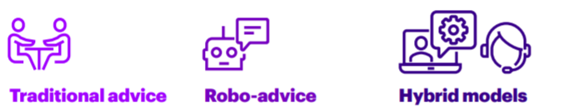
What are Robo-advisors?
»
»
Robo-advisors are software solutions based on complex algorithms to provide financial advice & investment management without human input.
01
02
03

Slide 14
How they work
INPUTS
Financial status
Degree of risk aversion
Investment goal
Investment value
Algorithms
…the best portfolio of stocks available based on that data

Slide 15
Advantages & Disadvantages of Robo-advisors
Advantages
Disadvantages
Robo advisors charge lower fees due to price cuts
The minimum balance requirements is often lower
State of art algorithms
Decisions made based on algorithms, not emotions
No human error possibility
Wider client base
The algorithms haven’t been tested properly yet
Lack of human level interaction, no personalized advice considering personal situations
Employees are being replaced with technology; less job opportunities

Slide 16
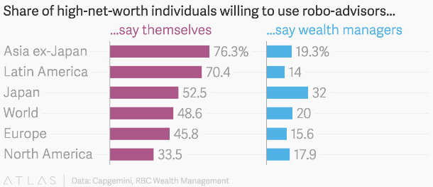
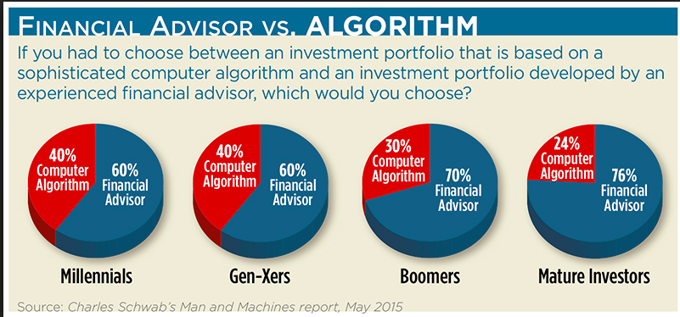
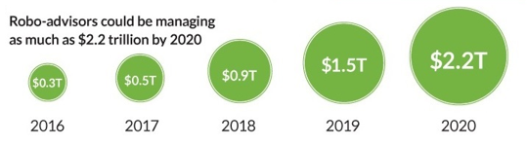
Customer Profile & Future
Rather than an investment world being a sprint, it is like a marathon and robots don’t need to sleep. They can make their calculations and movements while analysing all markets whatever the time.
Adam Nash (CEO of Wealthfront)

Slide 17
Virtual
Reality

Slide 18
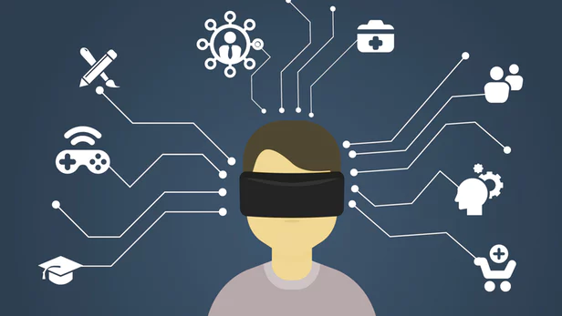
Virtual Reality
“A three-dimensional, computer generated environment which can be explored and interacted with by a person”

Slide 19

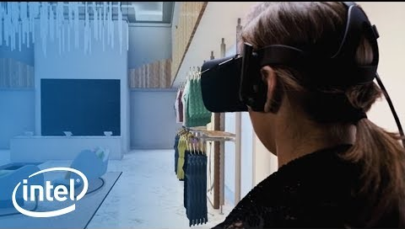

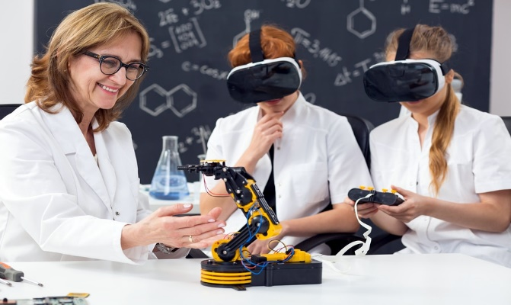

Application of VR
VR’s ability to give it’s users a sense of presence means that it can be used to simulate everyday situations and tasks.
VR is used in various industries entertainment, architecture, fashion, health care, automobile industry, arts (museums), education, military etc.

Slide 20
VR Systems & their uses
There are many different types of VR systems. However, they all share the same characteristic of allowing the user to view three-dimensional images that appear life-sized.
The table highlights common VR systems and some of their uses:
The Samsung Gear VR
PlayStation VR (Project Morpheus)
VR headset designed to work with Samsung’s flagship smartphones
USE: Gaming, health (meditation)
VR headset developed by Sony for the PlayStation 4
USE: Gaming, entertainment (TV)
Microsoft HoloLens (Project Baraboo)
Pair of mixed reality smart glasses running on a Windows 10 OS
USE: Gaming, virtual tourism, 3-D modelling
Oculus VR
VR headset with specialised VR displays
USE: Gaming, aviation (drones)

Slide 21
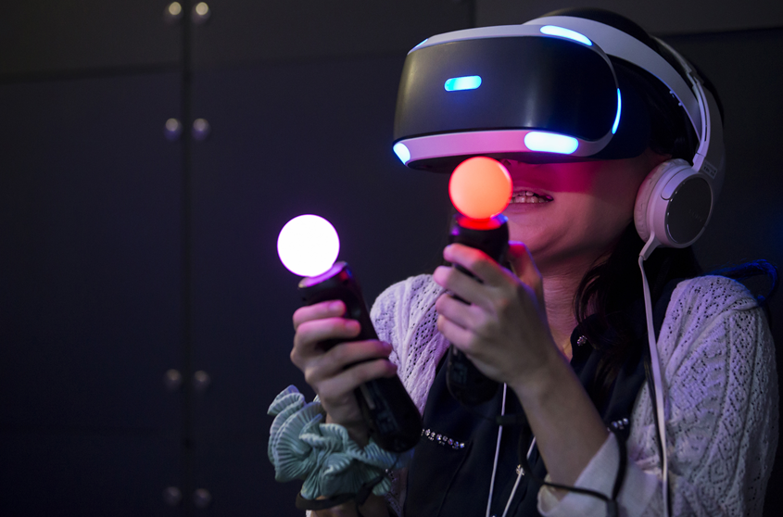
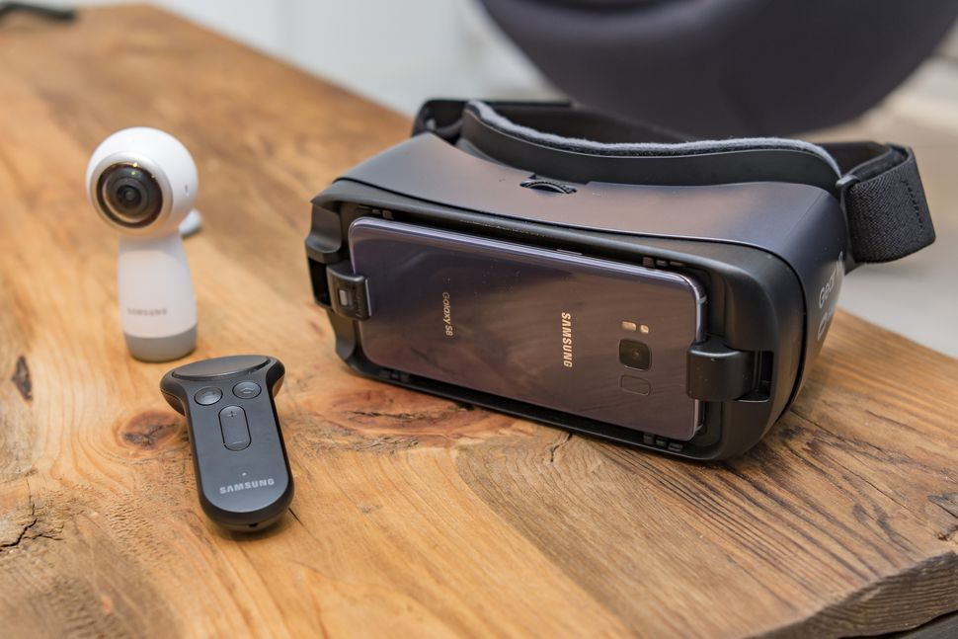
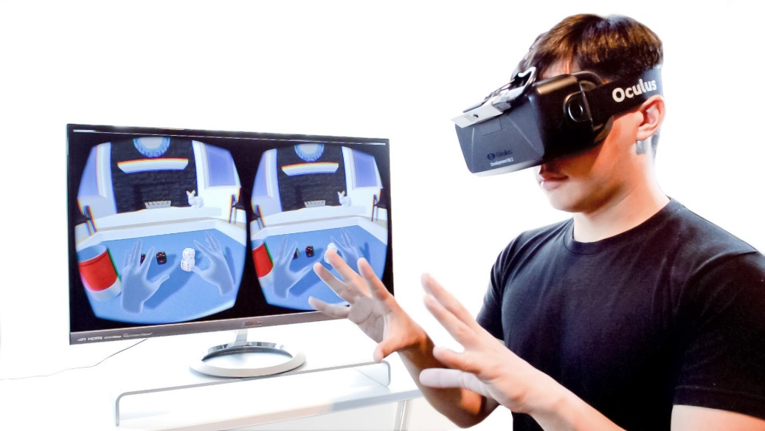
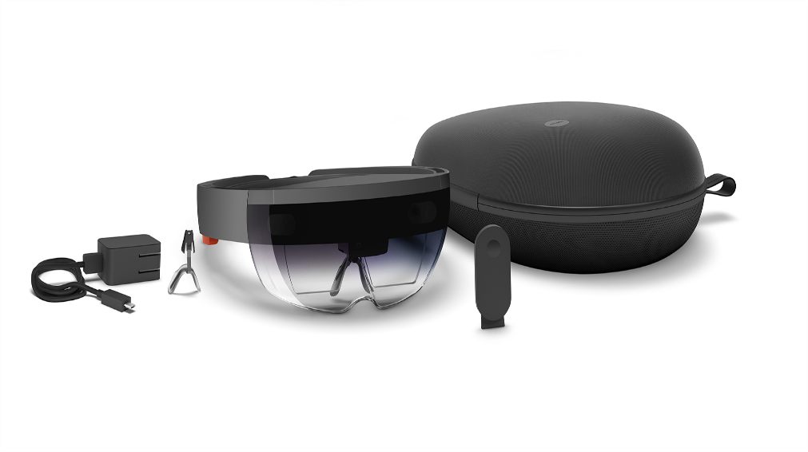
VR Systems
& their uses
PlayStation VR
The Samsung Gear VR
Microsoft HoloLens
Oculus VR

Slide 22
Issues with VR
In 2015, an experiment showed that VR has two shortcomings:
It lacks total virtual movement & a sense of where our body parts are. However, Virtuix Omni tackling this problem by releasing virtual reality locomotion devices that allow users to walk and run in VR for gaming and exercise.
Virtual movement
It isn’t able to pick up on senses such as smell and consequently, users are never truly fully immersed and engaged due to them using half the number of neurons.
Senses
VR is gender-biased. The eyes rely on Motion Parallax perception(MP) and Shape-from-shading perception (SFS). However, due to different sex hormones, women tend to mostly judge depth and dimension using SFS, whilst men tend to rely on MP.
Gender bias
This a possible explanation to why women get more “VR motion sickness” than men and why complete realism and immersiveness hasn’t yet been achieved.

Slide 23
Autonomous
Vehicles

Slide 24
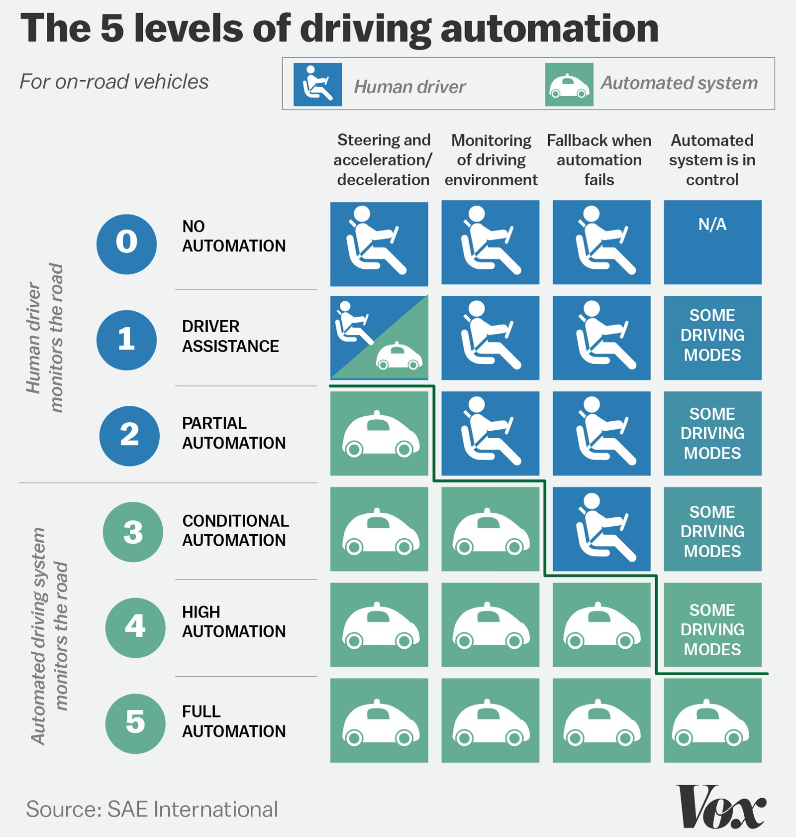
Five Levels of Driving Automation
0 ‘no automation’
5 ‘full automation’
Key distinction between levels 2 and 3
Currently:
Stage 2 / 3
For full autonomy:
cameras, sensors, radar, Lidar, GPS, AI, machine learning systems

Slide 25
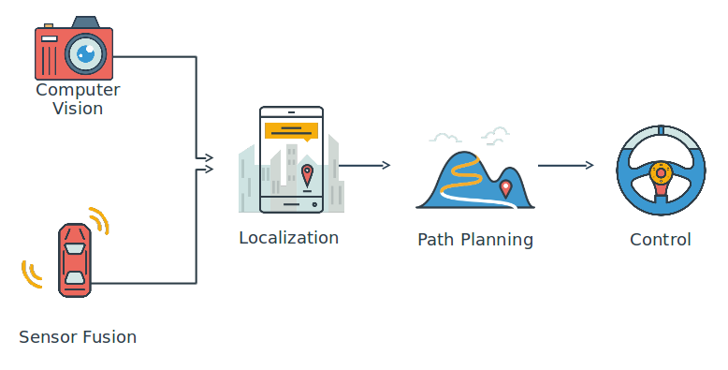
Key Technologies of Intelligent Vehicles

Slide 26
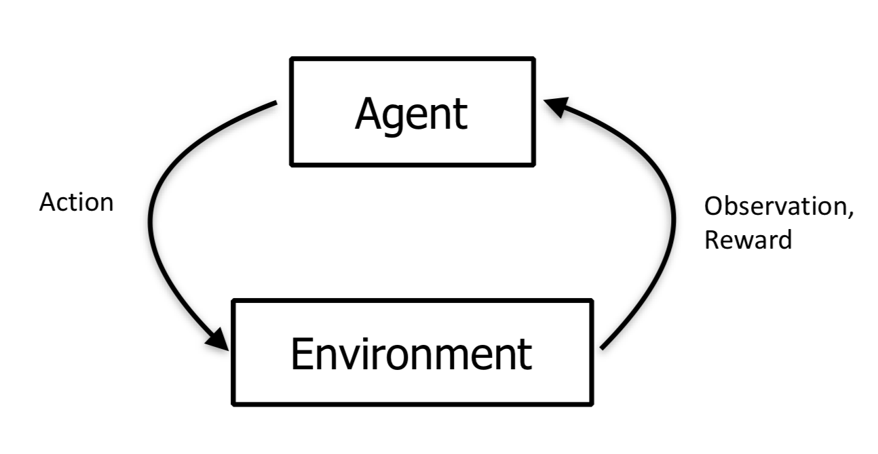
Reinforcement Learning
Reward hypothesis
Inspired by animals’ trials-and-error cognitive process
Teach a machine to select actions that maximise total future reward
Exploration vs Exploitation

Slide 27
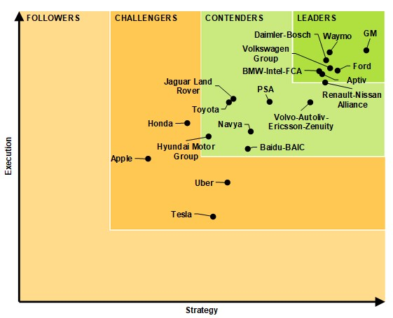
AV Systems Companies Leaderboard

Slide 28
The Future
of Artificial Intelligence

Slide 29
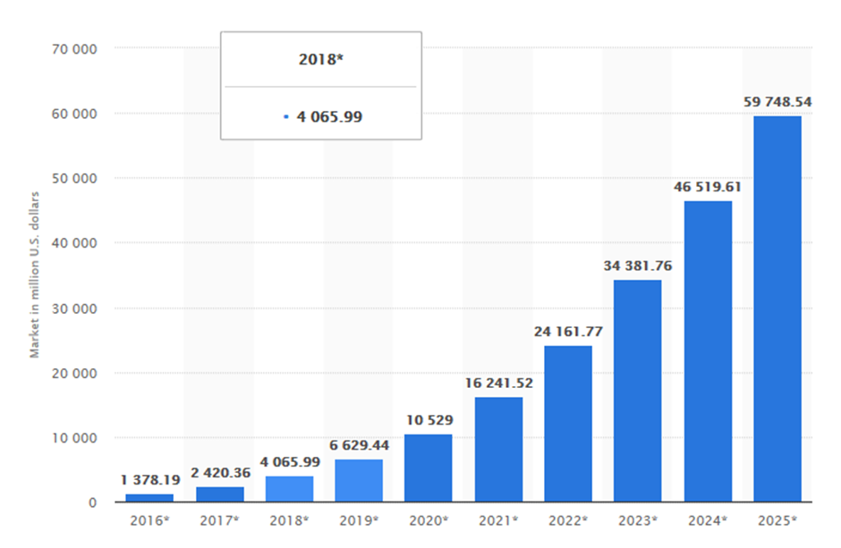
The market trends of AI
$20-30 billion
The win of AlphaGo makes people realize the potential of AI.
$20-30billion spent globally on AI in 2016, dominated by digital giants like Google and Baidu）
In 2016, only $1.378 billion revenue
90% was invested in R&D; hence few products on market
2. successful case has proved the feasibility of AI
The example of Fukoku mutual life insurance: 34 employees replaced by Watson
AI will be more commercialize
The revenue grow rapidly in the future
90% in R&D
Rapid growth

Slide 30
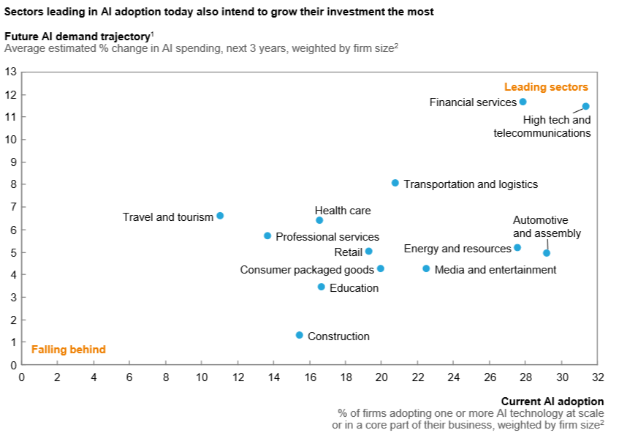
AI & Finance
Large amount of accurate historical data
machine learning is dependent on data
Financial activities have clear aims
make profits or control risk
Rank the 3rd in current AI adoption
with the highest Future demand trajectory
Finance is the industry that AI will be mainly applied to in the future years.

Slide 31


AI & Healthcare
30-50% productivity improvement for nurses supported by AI tools. Up to 2% GDP savings for operational efficiencies in developed countries.
£3.3 billion possible saving in the UK using AI to provide preventive care and reduce nonelective hospital admissions.
The potential of AI in healthcare
5-9% health expenditures reduction by using machine learning to tailor treatments and keep patients engaged.
$2 trillion-$10 trillion savings globally by tailoring drugs and treatments.
+0.2 to 1.3 years of average life expectancy.
Notes:
How AI can help to make diagnoses more accurate than experienced doctor…
http://players.brightcove.net/734546229001/default_default/index.html?videoId=5633679073001
https://www.intel.com/content/www/us/en/healthcare-it/article/improved-diagnosis.html

Slide 32
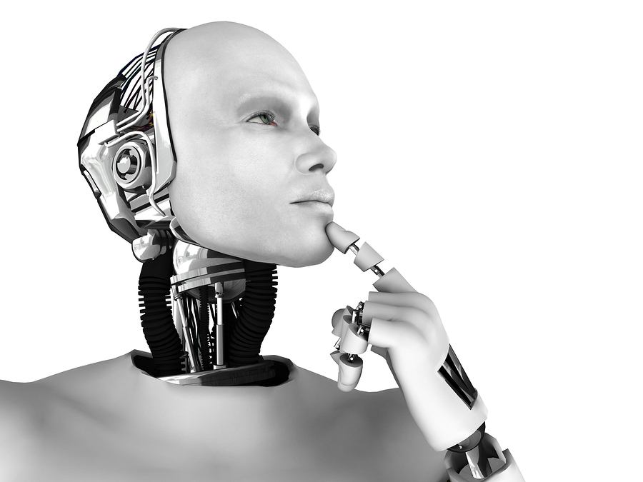
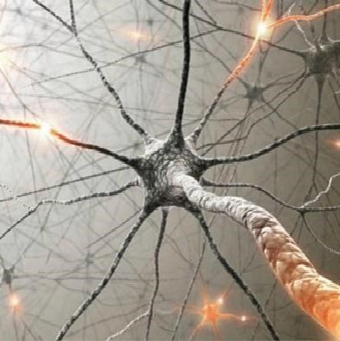
Artificial general intelligence (AGI)
We are still far away from artificial general intelligence….
Challenges to achieve AGI:
AGI refers to an intelligence of a machine that could successfully perform any intellectual task that a human being can. It is also called “Strong AI”
The computing and data storage capabilities
There are roughly 100 billion neurons and 1 quadrillion synapses in human brain
To explore how human brain works
Lack of professionals
300 thousands now, 20 thousands graduates per year, the total demand is more than 1 million

Slide 33



Glasgow University
FinTech Society
Artificial Intelligence workshop
15 Feb 2018, 5:30-7pm Boyd Orr Building, room 506, Glasgow University
» Topics covered at the workshop:
» Guest speaker
What is Artificial Intelligence
Robo-advisors in investment banking
Virtual Reality
Elias Mistler
Data Scientist @ Previse
Self-driving cars
AI & Blockchain
“Previse uses Artificial Intelligence to enable corporate buyers to safely ensure they pay all their suppliers instantly.”
UoG FinTech Society | @UoGfintech | info@uogfintech.com | www.uogfintech.com

